Slide 1

CAPSTONE PROJECT DEFENSE
AI-Powered Examination and Programming Practice Platform for FPT University
Group Members:
Vu Hoang Anh – HE172381
Nguyen Viet Duc – HE176246
Phan Duy Hung – HE173329
Pham Quoc Minh – HE172395
Nguyen Viet Sang - HE172569
Dr. Nguyen Manh Hien
Supervisors:
Group: SEP490_G26

Slide 2






TARGET
01
Project Overview
Understand the project context and objectives.
02
Project Management Plan
Plan and forecast workload, timelines, and potential risks.
03
SRS & SDS Documentation
Understand the project's key business workflows through diagrams.
04
Software Test Documentation
A set of technical manuals comprising the test plan, test cases, and test report.
05
Lession Learn
Lessons learned from the project
06
Demo and Q&A
Illustrate the project's key business processes.
02

Slide 3
01
PROJECT OVERVIEW
 | Description
Project Name | AI-Powered Examination and Programming Practice Platform for FPT University (APE)
Product Background | Currently, IT students at FPT University, as well as those at other technology-focused universities, face significant difficulties in mastering programming-intensive courses.
Baseline Systems | Codelearn, LeetCode, Gemini Notebook, Quizlet.
Background & Baseline Systems
04

Slide 4
01
PROJECT OVERVIEW
No | Problem | Description
1 | Lack of Practice Environment | Provides browser-based MCQ and PE practice environments, eliminating the need for local setup.
2 | Lack of Learning Materials | Features AI-powered exam generation directly from existing study materials.
3 | Inability to Self-Assess Code Quality | Integrates an AI Mentor to review code and evaluate submission quality.
4 | Personalized Material Repository | Allows users to upload personal documents for AI analysis and automated question generation.
THE PROBLEM GAPS
03

Slide 5
01
PROJECT OVERVIEW
AI-Powered Document Ingestion & Vectorization
AI-Powered MCQ & PE Generation from Uploaded Documents
APE
Isolated Coding & MCQ Workspace
AI Code Mentor
MAJOR FEATURE
05

Slide 6
02
PROJECT MANAGEMENT PLAN
02
Scope: The project is delivered within the 15 week Capstone Project timeline at FPT University, covering documentation, implementation, and testing.
Estimation: Each Work Breakdown Structure item is assigned a complexity level (Simple, Medium, Complex) and an estimated effort in man-days; group rows are subtotals of their items. Complexity convention - Simple: 2–4 md; Medium: 5–7 md; Complex: 8–12 md. Estimates are allocated across 5 members (4 Developers + 1 Business Analyst) and include design, implementation, unit testing, system testing and integration testing per item.
06

Slide 7
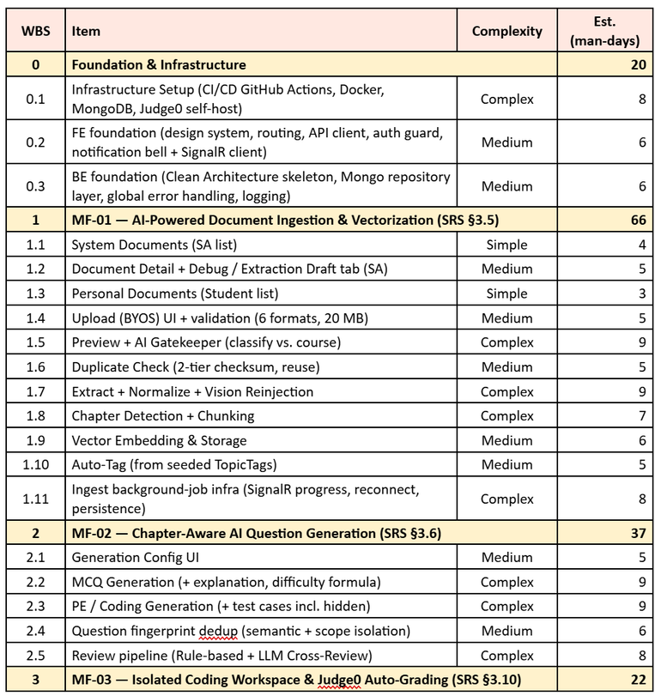
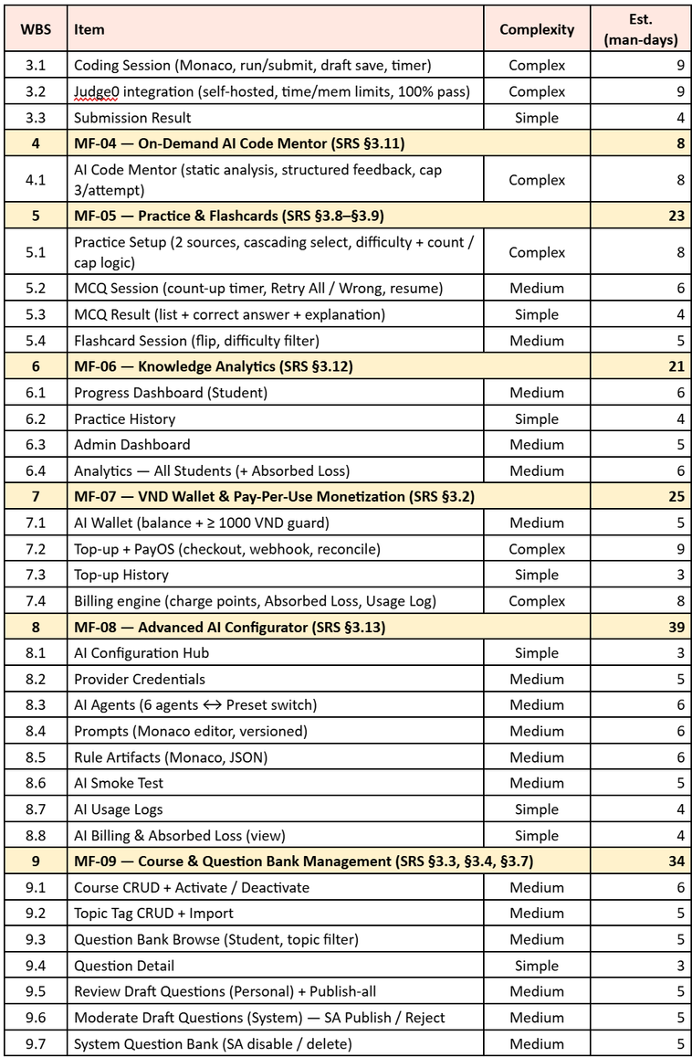
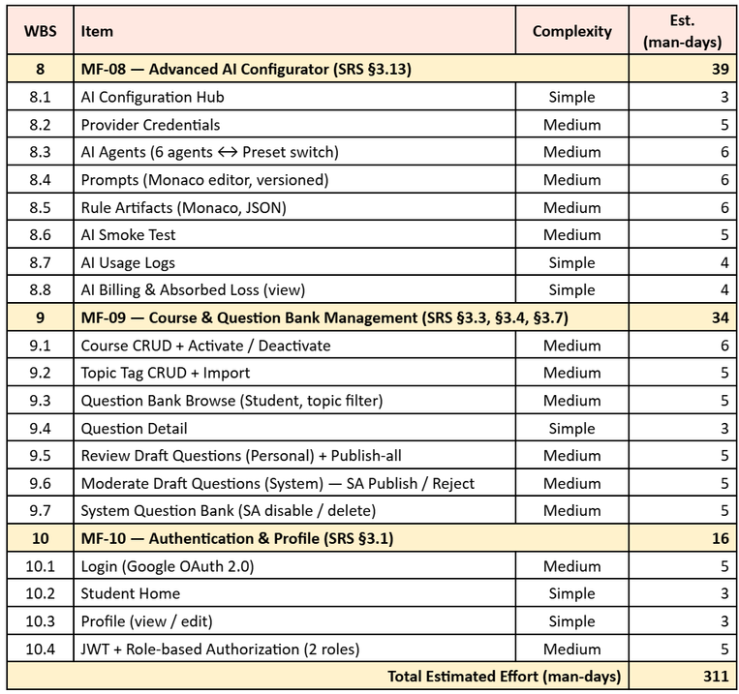
02
PROJECT MANAGEMENT PLAN
07

Slide 8
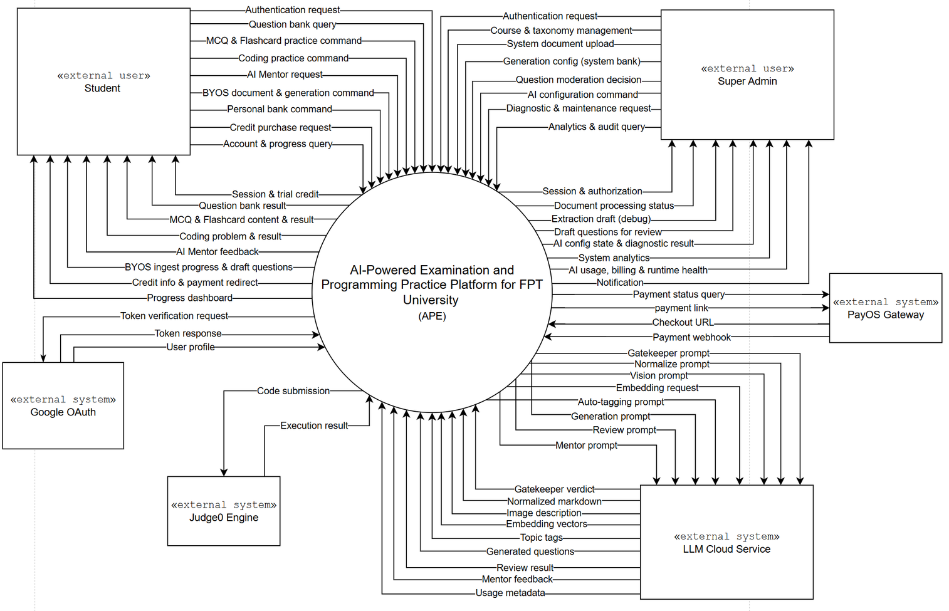
03
SRS & SDS DOCUMENTATION
03
SRS & SDS DOCUMENTATION
Context Diagram
08

Slide 9
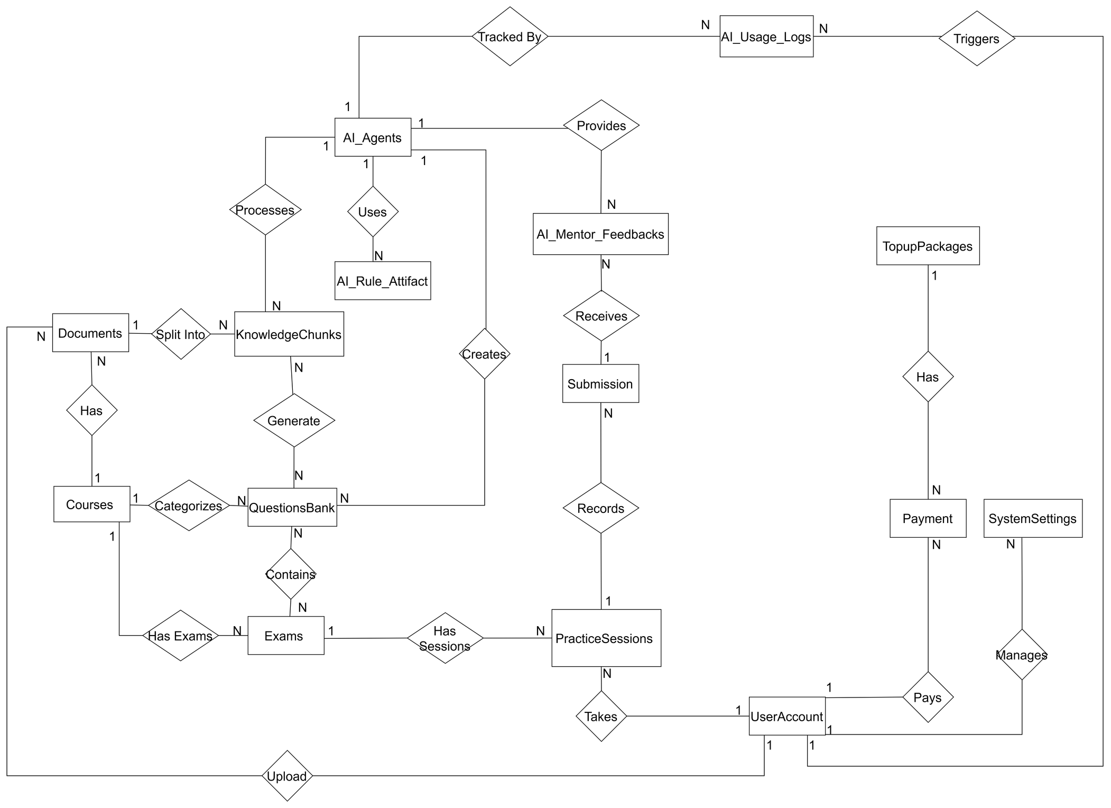
03
SRS & SDS DOCUMENTATION
Entity-Relationship Diagram
09

Slide 10
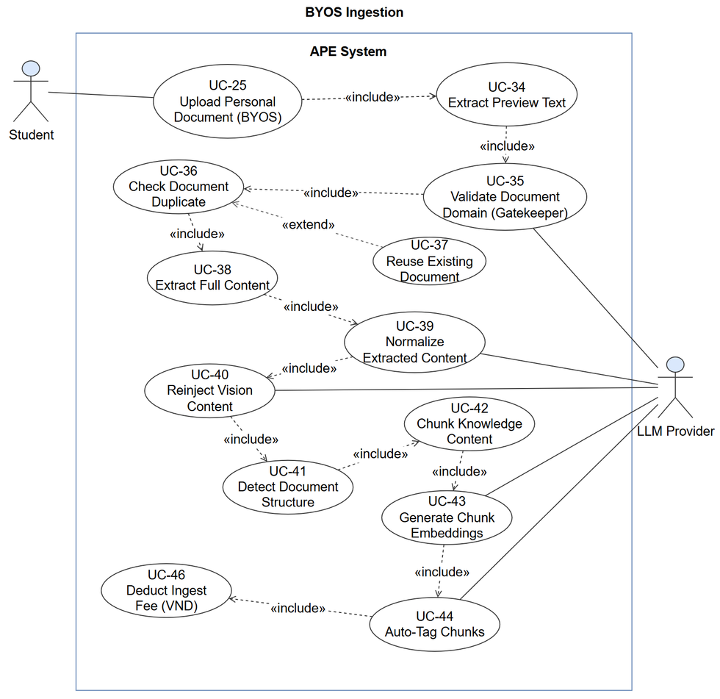
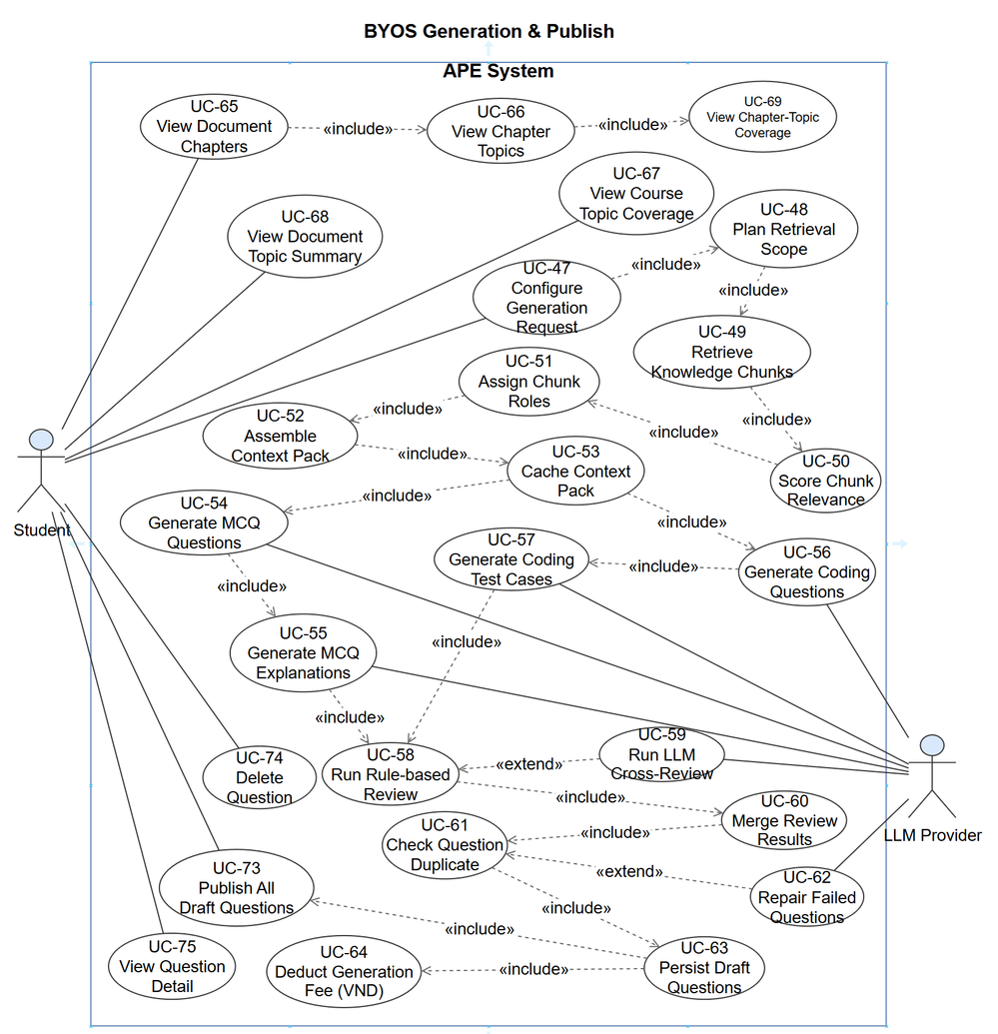
03
SRS & SDS DOCUMENTATION
Usecase Diagram
10

Slide 11
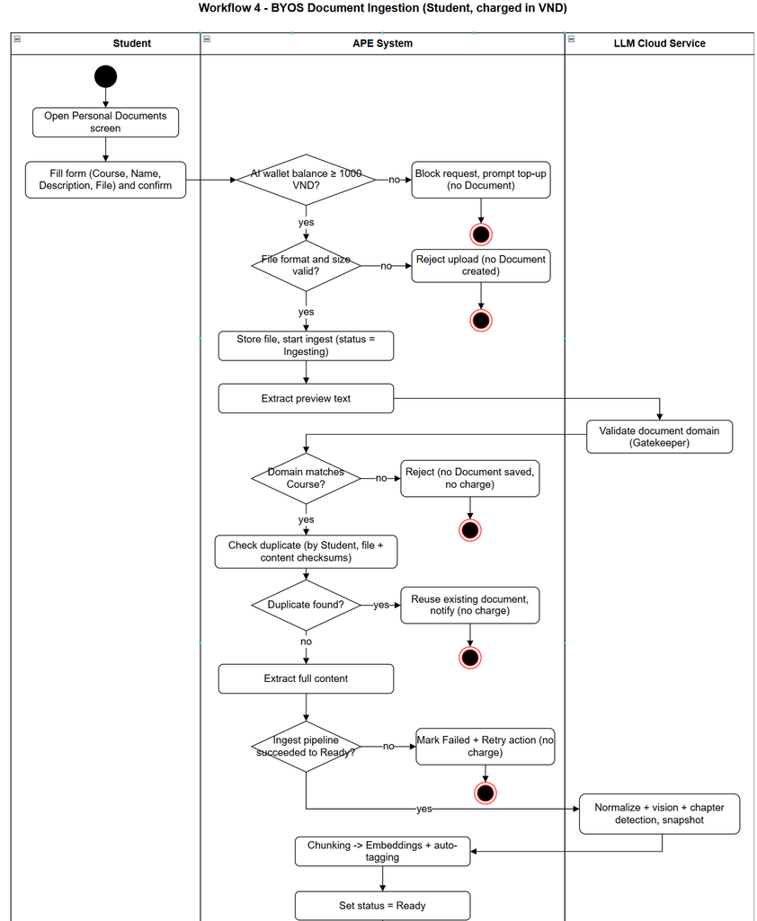
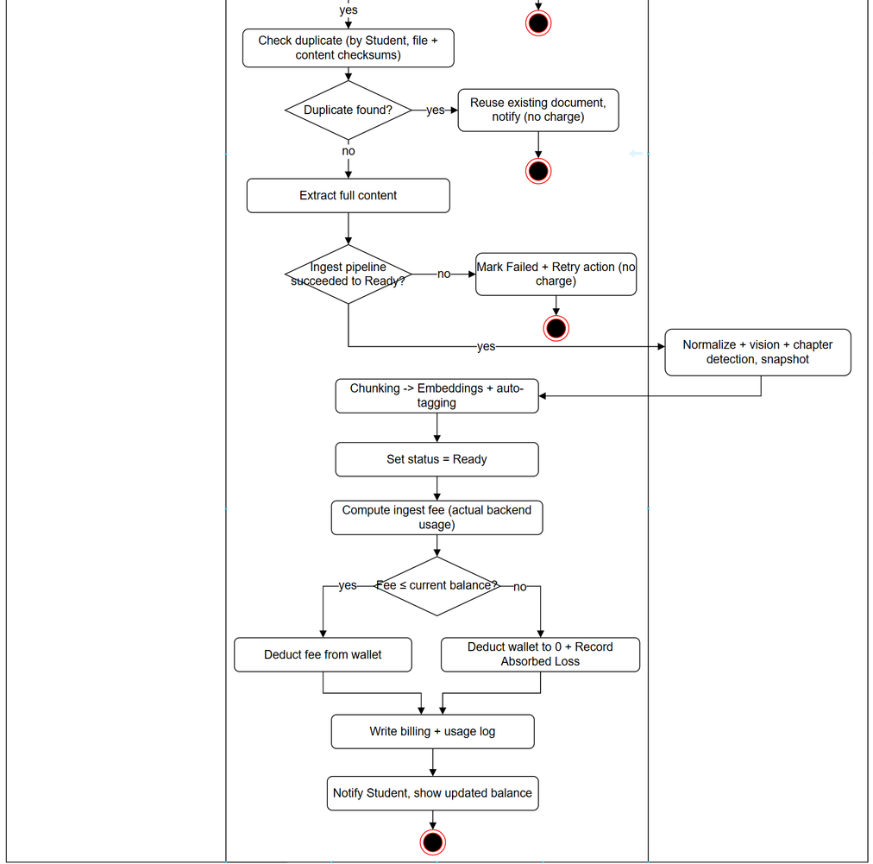
03
SRS & SDS DOCUMENTATION
Swimlane Diagram
11

Slide 12
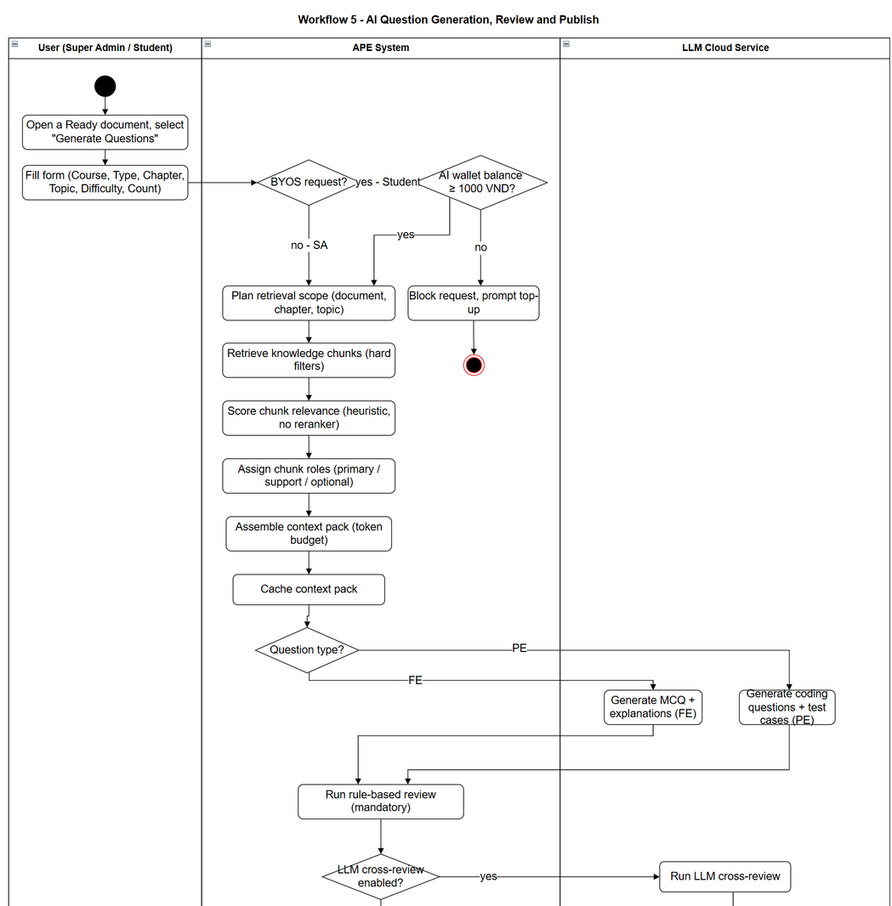
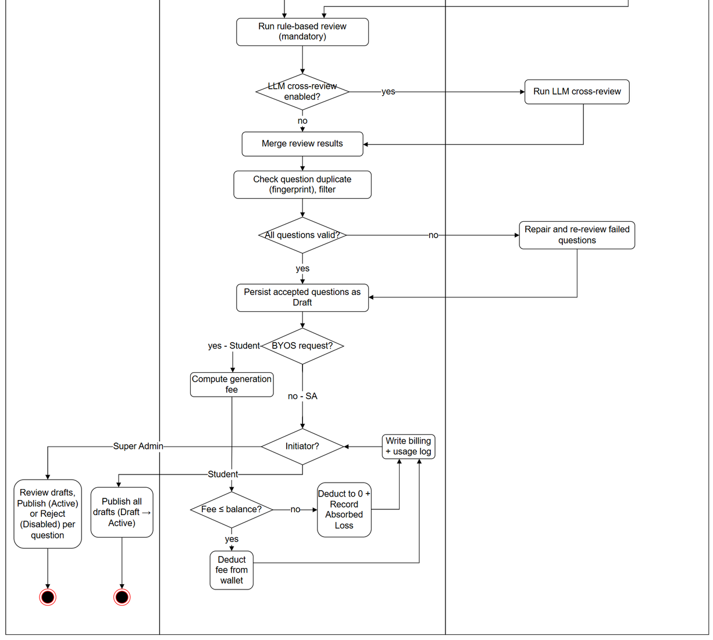
03
SRS & SDS DOCUMENTATION
Swimlane Diagram
12

Slide 13
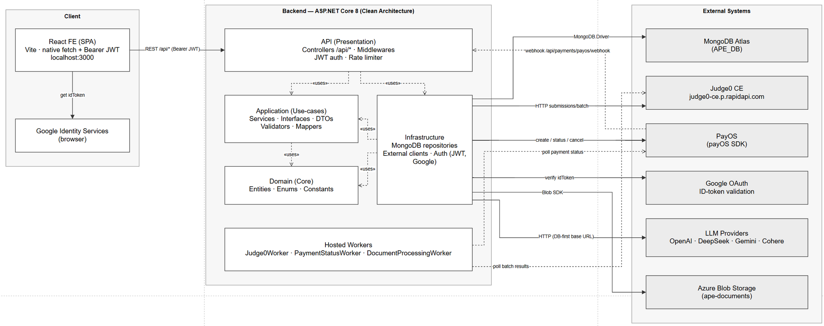
03
SRS & SDS DOCUMENTATION
Software Architecture Diagram
13

Slide 14
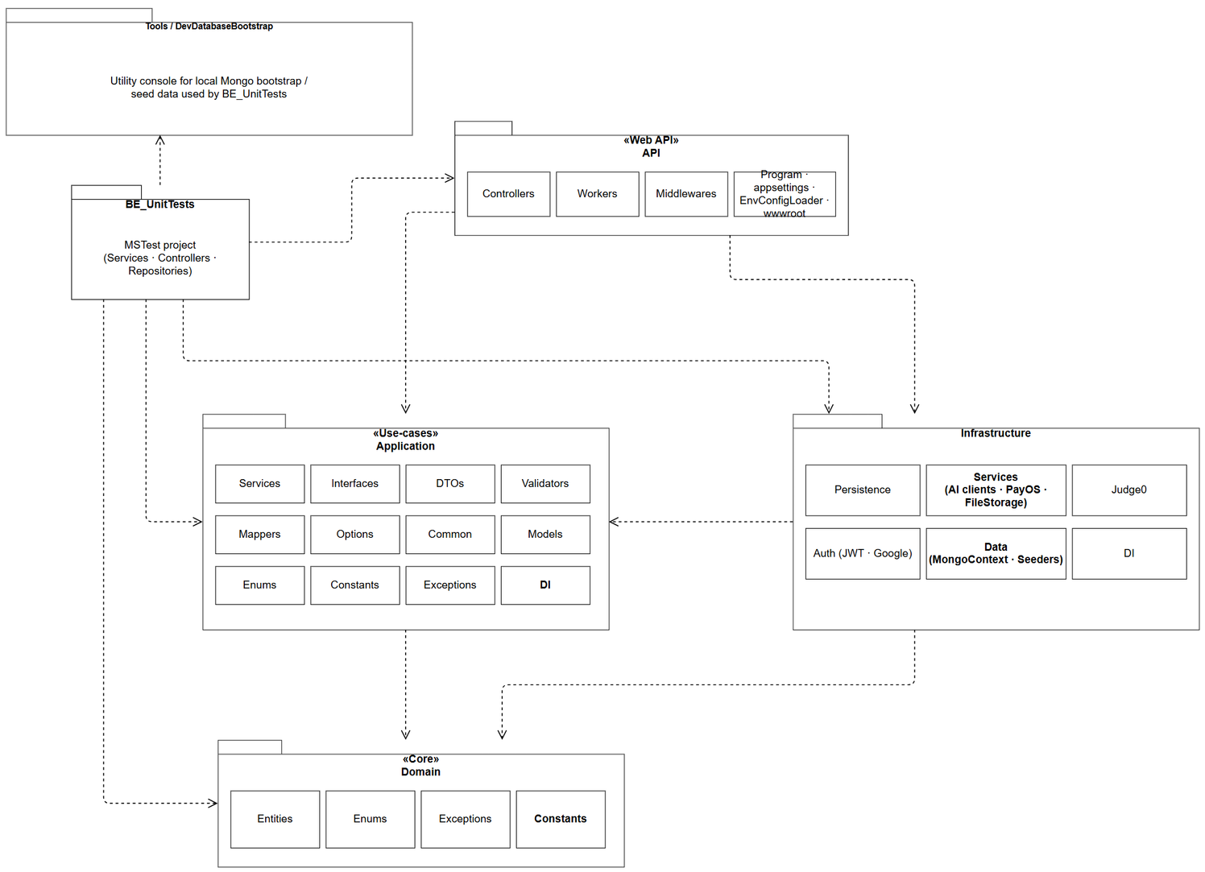
03
SRS & SDS DOCUMENTATION
BE PACKAGE DIAGRAM
14

Slide 15
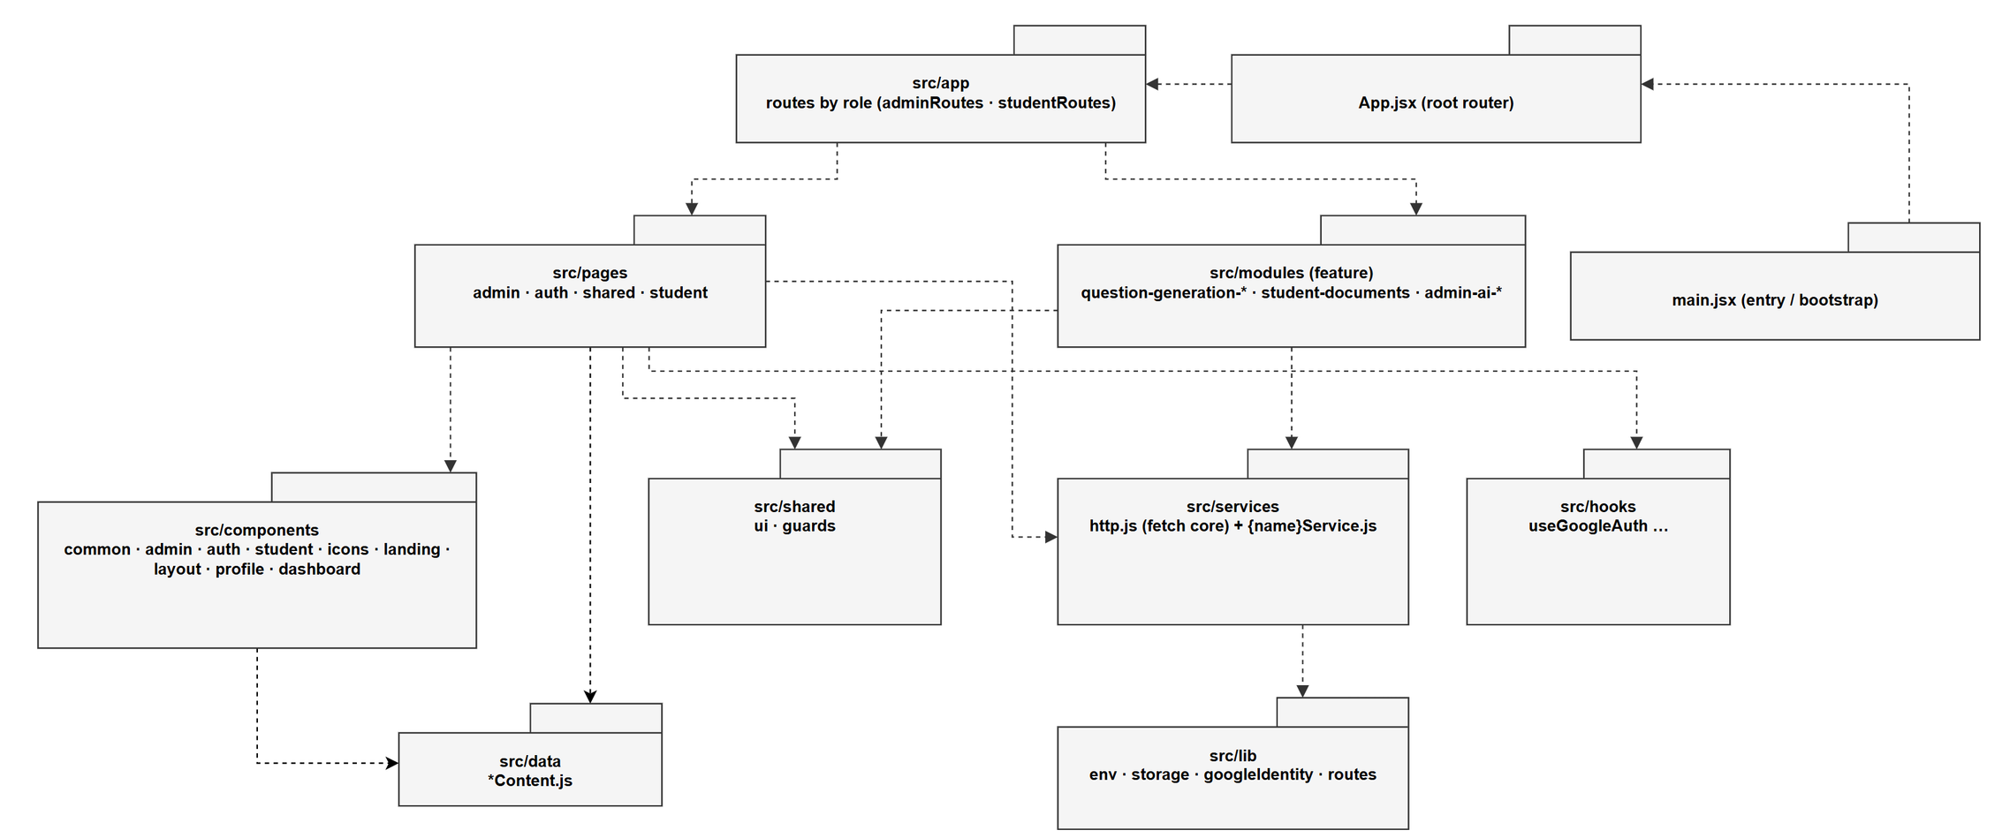
03
SRS & SDS DOCUMENTATION
FE PACKAGE DIAGRAM
15

Slide 16
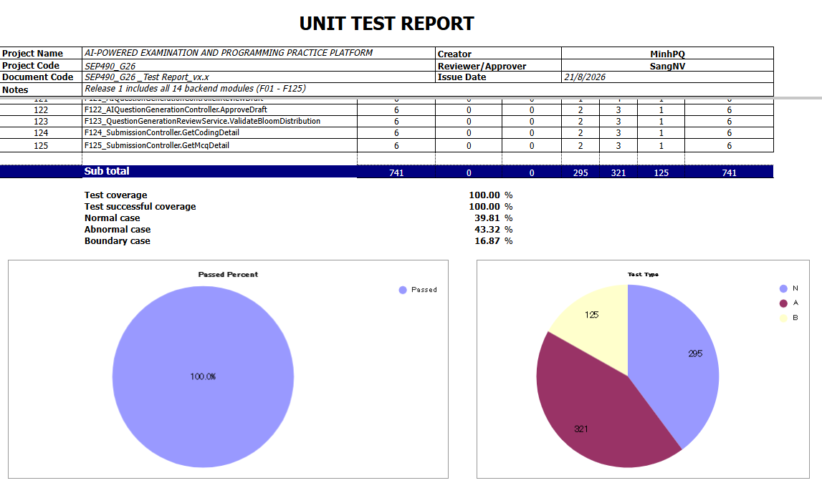
04
SOFTWARE TEST DOCUMENTATION
Unit Test Report
16

Slide 17
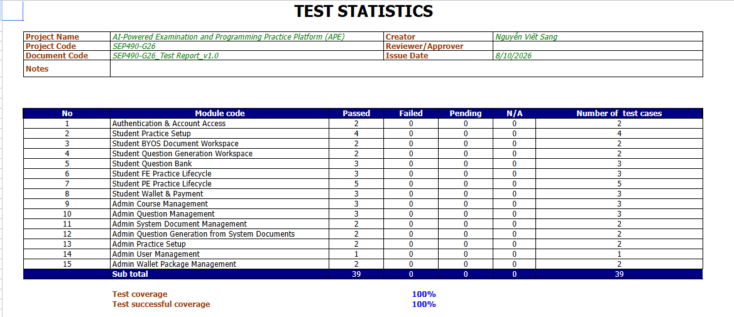
04
SOFTWARE TEST DOCUMENTATION
Intergration Test Report
17

Slide 18
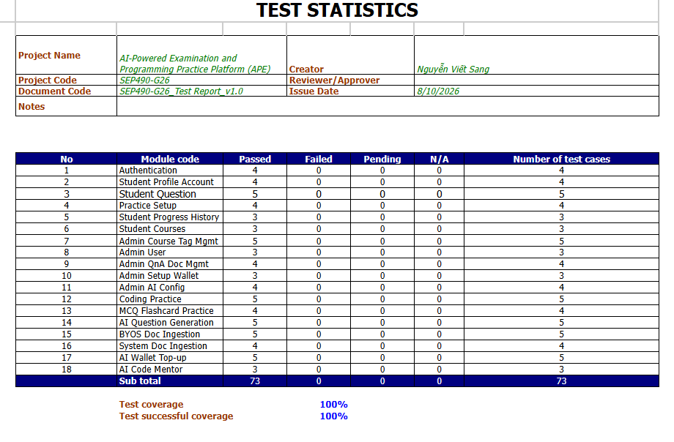
04
SOFTWARE TEST DOCUMENTATION
System Test Report
18

Slide 19
05
LESSION LEARN
Effective teamwork requires clear roles, shared conventions, and disciplined communication
01
Documentation-driven development is the backbone of a serious project — building the system strictly from SRS, UC specifications, and SDS gave the whole team a shared source of truth and eliminated ambiguity about what to build and why.
02
Systematic testing is a mindset, not a final step — applying unit, integration, system across the sprint cycle showed us that quality must be planned from day one, not squeezed in before the demo.
03
19

Slide 20

06
DEMO AND Q&A
20

Slide 21
Thank you!

